Slide 1
Unit 2 overview: the challenge of utopia
8th grade Springboard

Slide 2
Learning targets
I can preview the big ideas and vocabulary for the second part of the unit.

Slide 3
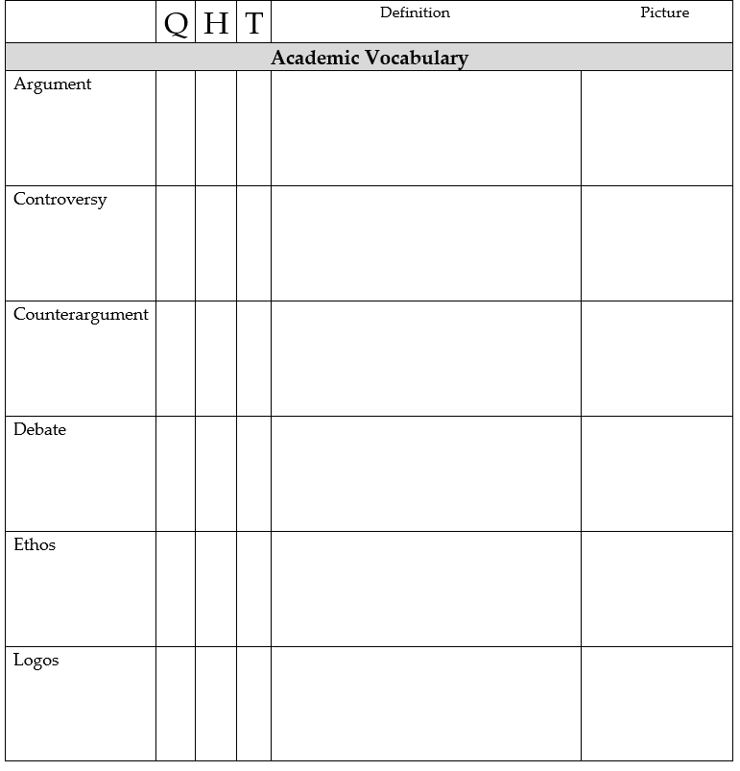
Question, heard of, teach it
You should have completed the QHT for the second part of the unit.
Due today.

Slide 4
Unit overview: Part 1
To analyze and evaluate a variety of explanatory and argumentative texts for ideas, structure, and language.
To understand the use of active and passive voice.
To develop effective arguments using logical reasoning, relevant evidence, and persuasive appeals for effect.
Directions
Read the goals for the unit and circle any words that are unfamiliar to you.

Slide 5
contents
Skim/scan the activities and texts, beginning with activity 2.10.
Mark the text with a WOW or WHOA
Wow= interesting
Whoa= challenging

Slide 7
Unit overview
Mark the text by underlining words and phrases that help you predict what the unit will be about.
Think-Pair-Share

Slide 8
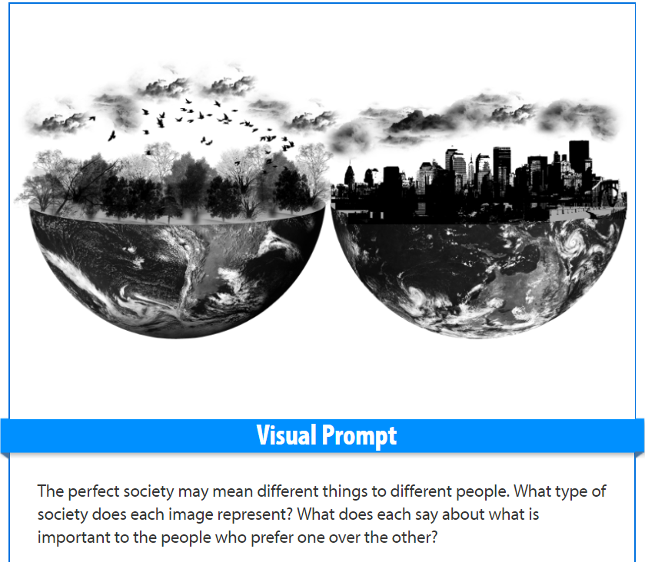
Visual prompt
Discussion: What would an ideal society look like?

Slide 9
Unit overview: Part 2
Read the goals for the unit and circle any words that are unfamiliar to you.
To analyze a novel for archetype and theme.
To develop informative/explanatory texts using the compare/contrast organizational structure.

Slide 10
contents
Skim/scan the activities and texts, beginning with activity 2.1 and ending at the EA.
Mark the text with a WOW or WHOA
Wow= interesting
Whoa= challenging

