Slide 1
Activity 2.7: Gathering Evidence from a Film– Part One.
7th Grade Springboard

Slide 2
Learning Targets
I can analyze film to assess its purpose and credibility.
I can identify and record relevant research information from a film.
I can participate in a collaborate discussion about research findings.

Slide 3
Film Study
To help you understand the genre and purpose of the film The Myth of Choice: How Junk-Food Marketers Target Our Kids, record details using the following graphic organizer as you listen to information about the film.
Role
Audience
Format
Topic

Slide 4
RAFT- Paragraph Read Aloud
There will be four groups. Each group will be assigned a specific part of RAFT.
1st: I will read the passage and you will listen for your specific part of RAFT.
2nd: Take notes on the graphic organizer as you hear your part of RAFT.
3rd: The passage will be on the board and you will look for your specific part of RAFT and take notes again or change your answer.

Slide 5
Passage
Every year, some of the world’s largest corporations spend billions on marketing, advertising, and lobbying campaigns to shape the way we think about food; much of that money specifically targets children and teenagers. These multibillion dollar messaging campaigns obscure the reality that highly processed food, sugary drinks, and industrial agriculture are harming our health, economy, and the planet. Meanwhile, across the country, fast-food chains are crowding out grocery stores and supermarkets, narrowing the healthy food choices available. But a growing movement of people is fighting back and speaking up for a sustainable and fair food system. An initiative of the Real Food Media Project, led by author Anna Lappe, Food MythBusters is a collaboration among some of the leading food and farming organizations in the country with the goal of spreading the real story about what we eat. Their animated movie The Myth of Choice: How Junk-Food Marketers Target Our Kids takes on the myth of personal choice and exposes the harmful impact on marketing to kids.

Slide 6
Role
Who created the film?
Inference: Researchers, those opposed marketing junk food to kids.
Evidence: “An initiative of the Real Food Media Project, led by author Anna Lappe, Food MythBusters is a collaboration among some of the leading food and farming organizations in the country with the goal of spreading the real story about what we eat. Their animated movie…”

Slide 7
Audience
Who do you think it was created for?
Inference: Children and teenagers
Evidence: “Their animated movie The Myth of Choice: How Junk-Food Marketers Target Our Kids takes on the myth of personal choice and exposes the harmful impact on marketing to kids.”

Slide 8
Format
What type of film is it? How will the information be presented? Is the film a primary or secondary source?
Inference: Documentary in the form of a film. It is a secondary source.
Evidence: The passage refers to it as an animated movie/film, and therefore the information will be presented in the form of a film. It is a secondary source because it is analyzing information that could be considered primary sources.

Slide 9
Topic
What will this be about? What is its purpose?
Inference: Advertising junk food and how it’s impacted kids. The purpose is to inform us about the myth of choice regarding food.
Evidence: “The animated movie… takes on the myth of how personal choice exposes the harmful impact of marketing to kids.”

Slide 10
Documentary Film
2. Use the graphic organizer on the next page or some other form handout to take notes about the film that might help you answer the research questions you have selected. Write your research question(s) below in your notebook.

Slide 11
Notebook
Date Advertising Research Questions pg.

Slide 12
Advertising Research Questions
What techniques are used especially for young audiences?
Why are teens and tweens important to advertisers?
How effective are ads targeted to teenage audiences?
What role does advertising play in the lives of youth?

Slide 13
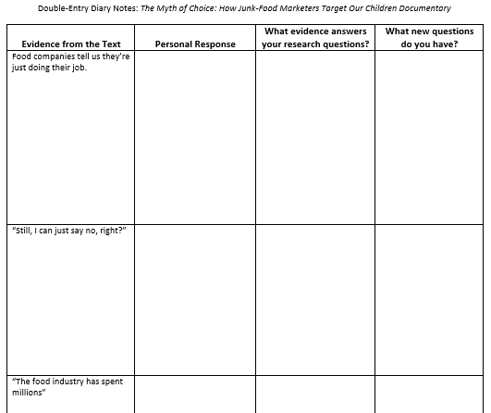
Handout
Complete the handout as you watch the animated documentary/film.
Think about your chosen research questions (2) as you view the film.
http://foodmyths.org/myths/marketing-advertising/

Slide 14
Collaborative Discussion
In preparation for a group discussion, answer the following questions on the back of the handout:
How did this resource help you answer your research question?
What additional information did you find interesting?
What is one other question the film prompted you to think about?
Respond to the Essential Question: How do advertisers attempt to influence consumers, specifically youth?
From what you can tell, how reliable or credible is this source?

