Slide 1
Activity 2.5:Advertising for All
7th Grade Springboard

Slide 2
Learning Targets
I can analyze and discuss advertising for commonly used products and how it affects consumers.
I can analyze the purpose, claims, and techniques used in an ad.
I can explain the impact of brands and celebrity endorsements in an explanatory paragraph.

Slide 3
The Effect of Advertising on Consumers
Media is supported by advertising.
Advertising= print, video, and sound communication.
Business try to convince people to buy products.
Online advertisements: pop up ads

Slide 4
The Effect of Advertising on Consumers: 2 min.
Respond to the questions that follow:
Where else do you see ads?
Do you ever see ads in your school? If so, where and when?

Slide 5
The Effect of Advertising on Consumers: 2 min.
2. Now, with your group, talk about your impressions, feelings, and reactions to advertisements. Are they necessary, annoying, interesting, or funny? Are they effective? Be sure to practice the skills necessary to engage in a collaborative discussion.
* See Collaborative Discussion Sentence Starters

Slide 6
Consumer Choices: 5 minutes
3. Think about some of the things you recently wanted to buy.
Next to each category in the chart below, list at least one specific item that you wanted to buy or wanted someone else to buy for you within the past year.
You may leave some categories blank. In the last column, note whether or not you saw an advertisement for the product.

Slide 7
Consumer Choices: 2 min.
4. Choose one of the items for which you saw an ad. Who was the target consumer for this ad? How do you know? What techniques were used?

Slide 8
Consumer Choices: 2-3 min.
5. Are you influenced by advertisements? Explain.

Slide 9
Celebrities and Marketing: 5 min.
6. In your table groups, identify famous singers, musicians, actors, or sports figures who have influenced how people dress or behave.
Consider these questions:
Why do we find them fascinating?
Why do we buy products endorsed by celebrities?

Slide 10
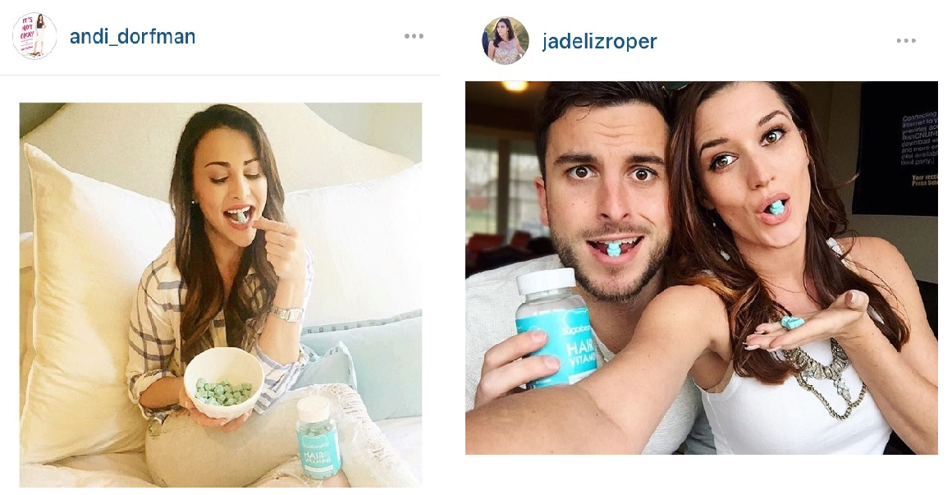
Celebrities and Marketing
7. Many celebrities earn millions of dollars promoting products to consumers. Working again in your table groups, identify two celebrities who regularly promote particular products.
Class example:
Celebrity: Selena Gomez, Bachelor contestants
Product: Pantene, blue gummy vitamins

Slide 11
Notebook
Date Celebrity Ad Writing Prompt pg.

Slide 12
Writing to Sources: Explanatory Text
Using evidence from the advertisements you have analyzed so far, respond to the following question in a well-developed paragraph: Why can celebrities have a significant influence on consumer choices?
Be sure to:
Introduce your topic clearly.
Develop your topic with relevant details and examples.
Express your ideas with precise, clear language, and avoid wordiness.

Slide 13
Outline
Topic Sentence
Example/Detail
Cite
Commentary
Example/Detail
Cite
Commentary

Slide 14
Sample
Topic Sentence
Celebrities can have significant influence on consumer choices because they are recognizable and admired by the target audience.
Example:
For example, Selena Gomez has been a spokesperson in advertising for the shampoo line Pantene.
Commentary (your own words)
This shows that a business believes that a television star that is recognized and popular can convince a population of TV viewers to buy their products using the testimonial technique.

Slide 15
Notebook
Date 2.5 Research Questions pg.

Slide 16
Writing Research Questions
Keeping the topic of marketing to children and young people in mind, write at least two more research questions (open-ended) in your textbook.

