Slide 1
Activity 2.4: How do they do it? Analyzing ads
7th Grade Springboard

Slide 2
Learning targets
I can identify techniques used in advertisements.
I can determine the purpose of persuasive advertisements and analyze how they use language to achieve that purpose.
I can write and expository response describing the effectiveness of advertising techniques in an advertisement.

Slide 3
Do advertisers tell the truth?
Legally they have to.
Stretch the boundaries of the truth.
Have you ever purchased a product and later felt tricked?
Can you think of any claims made by advertisers that stretch the truth?
Why do advertisers stretch the truth?

Slide 4
Notebook
Date 2.4 Advertising Techniques pg.

Slide 5
Avant-Garde
Advertising technique that makes the product seem so new that you will be the first to have it.

Slide 6
Bandwagon
Advertising technique that makes the product seem like everyone is buying it, so you feel like you need it too.

Slide 7
Testimonials
Advertisers use celebrities and regular people to endorse products.

Slide 8
Facts and figures
Statistics, percentages, and numbers are used to convince you that the product is better than another.

Slide 9
Transfer
Advertisers use the background of the ad or the story of the commercial to associate good feelings with the product.

Slide 10
Advertising techniques
To understand how advertisers market to teens, it is important to understand the many persuasive advertising techniques they use to make people want to purchase their products. Read the descriptions of advertising techniques that follow. Then paraphrase and create a visual representation of each technique. Your visualization may include both words and symbols.
Bandwagon
Avant-Garde
Testimonials
Facts and Figures
Transfer

Slide 11
Advertising techniques
2. As you read about the techniques, think about the cause and effect relationship in advertising. For example, with bandwagon the persuasion may be that “Everyone is buying this product (cause), so you should buy this product, too (effect).” With the avant-garde appeal, if might be “this product is the newest on the market (cause), and you should be one of the first to have it (effect).”

Slide 12
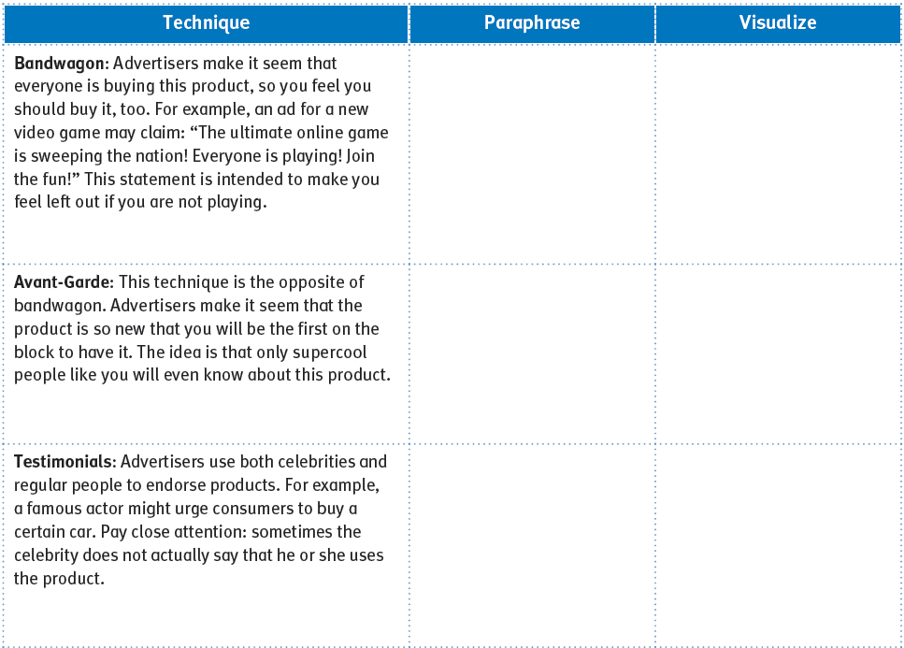
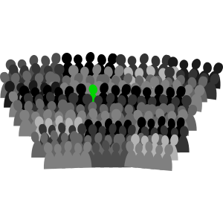
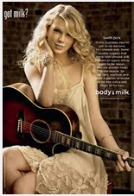
Everyone else has it, so I should have it too!!
Cool people have it, 1st to have it,
only SOME have it
(sense of being special)
People (normal or famous) say good things about product

Slide 13
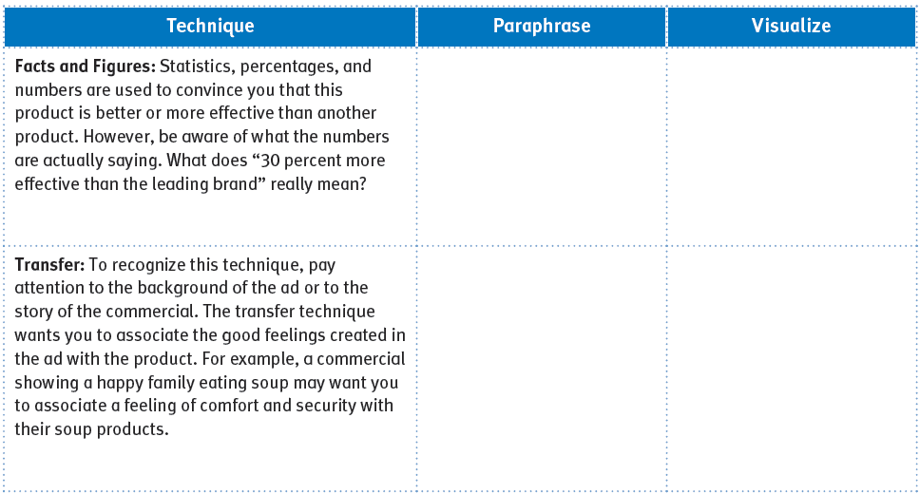
Statistics and percentages...but…
numbers can be misleading!!
(25% of what???)
Connect good feelings with a product - feel emotions about a product

Slide 14
Advertising techniques
3. What advertising techniques might you see together in one ad? Why would they work well together to influence an audience?

Slide 15
Practice Your Vocabulary Words by Analyzing Ads for each of the following words:
Testimonial
Transfer
Avante-garde
Bandwagon
Facts & Figures
Here we go...

Slide 16
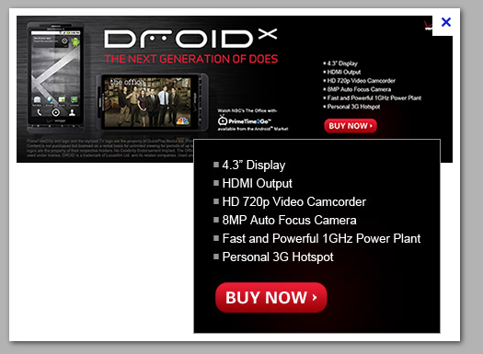
avant-garde
facts & figures
transfer & testimonial

Slide 17
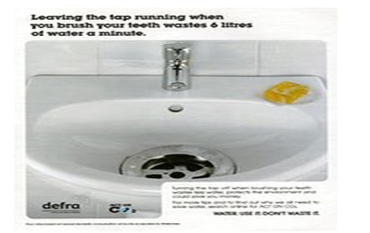
facts & figures
transfer
testimonial

Slide 18
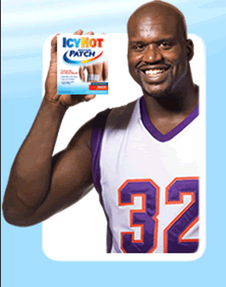
avant-garde
bandwagon
testimonial

Slide 19
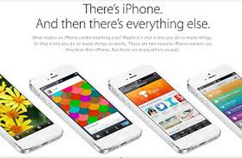
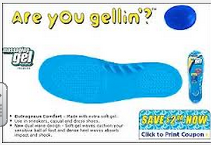
transfer
facts & figures
avant-garde
bandwagon

Slide 20
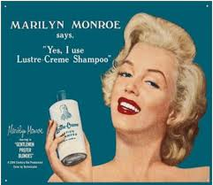
Practice Your Vocabulary Words by Analyzing Ads for each of the following words:
Testimonial
Transfer
Avante-garde
Bandwagon
Facts & Figures

Slide 21
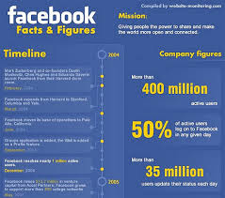
Practice Your Vocabulary Words by Analyzing Ads for each of the following words:
Testimonial
Transfer
Avante-garde
Bandwagon
facts & figures
It’s a secret...only the smart people know...

Slide 22
Practice Your Vocabulary Words by Analyzing Ads for each of the following words:
Testimonial
Transfer
Avante-garde
Bandwagon
facts & figures

Slide 23
Practice Your Vocabulary Words by Analyzing Ads for each of the following words:
Testimonial
Transfer
Avante-garde
Bandwagon
facts & figures

Slide 24
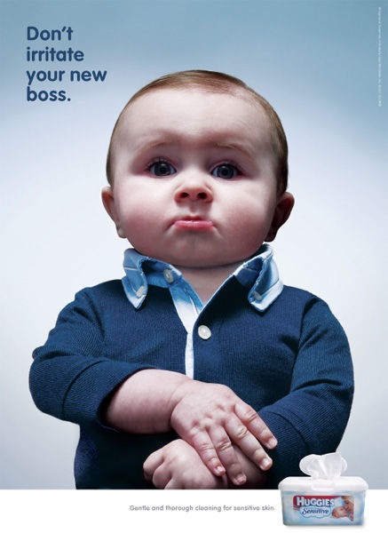
Practice Your Vocabulary Words by Analyzing Ads for each of the following words:
Testimonial
Transfer
Avante-garde
Bandwagon
facts & figures

Slide 25
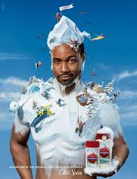
Practice Your Vocabulary Words by Analyzing Ads for each of the following words:
Testimonial
Transfer
Avante-garde
Bandwagon
facts & figures

Slide 26
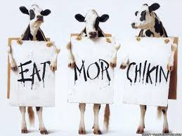
Practice Your Vocabulary Words by Analyzing Ads for each of the following words:
Testimonial
Transfer
Avante-garde
Bandwagon
facts & figures
being “different” or special
Only “certain” people do this

Slide 27
Advertising techniques
4. As you look at print, online, or television advertisements, analyze the use of advertising techniques. Circle the advertising technique(s) used in the ads and provide evidence (elaboration) for each technique used.
3 ads from 3 different brands.
Complete the graphic organizer.
Homework if not completed in class.
Due tomorrow first thing.

Slide 28
Pencil Ad!!!!
Please take out a pencil and grab a partner.
You will be assigned a specific ad technique. You will create a print ad to share with the class. The ad may have a slogan as well.
Due at the end of class. You present your ad first thing on Monday.

Slide 29
SKIP-- Check Your understanding
Think about an advertisement that you consider interesting and effective. You might consider if you or someone you know would buy this product based on the advertisement. Which persuasive technique does the advertiser use successfully? What is the cause-and-effect relationship being presented? Why do you think that particular technique was selected for the advertisement?

Slide 30
Notebook
Date 2.4 Vocabulary pg.

Slide 31
Explanatory writing
Is a form of writing whose purpose is to explain or inform.
Topic Sentence
Transition
Supporting Information
Commentary
Concluding Statement
Think TTSCC

Slide 32
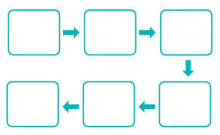
Coherence
The clear and orderly presentation of ideas in a paragraph or essay.

Slide 33
Explanatory writing
In contrast to a narrative, whose purpose is to tell as story, the primary purpose of explanatory/expository writing is to provide information or an explanation. Expository paragraphs follow a specific structure:
Topic Sentence
Transitions
Supporting Information
Commentary
Concluding Statement\

Slide 34
Notebook
Date 2.4 Explanatory Prompt pg. 101 pg._____

Slide 35
Writing to sources: Explanatory Text
For the ad on the right, write a response to the chosen advertisement that explains how it tries to influence its target audience. Be sure to:
Introduce and develop your topic with relevant details/examples from the advertisement.
Use transitions, the precise language of advertising techniques, and formal style.
Include a concluding statement that supports your explanation.

Slide 36
Language and Writer’s craft: revising for cohesion and clarity
Cohesion and clarity in writing refer to how ideas flow together. A way to write with cohesion and clarity is to use the TLQC format when writing a detail sentence. The TLQC format includes:
T: Transition word or phrase such as:
For example
According to,
To illustrate,
In this case,
In addition,
Most important,
Likewise,
Finally,

Slide 37
Language and Writer’s craft: revising for cohesion and clarity
Cohesion and clarity in writing refer to how ideas flow together. A way to write with cohesion and clarity is to use the TLQ format when writing a detail sentence. The TLQ format includes:
L– Lead in: The lead-in is usually a phrase that sets the context for the specific information that follows; it often answers the question Where? or When?
Q- Quote: A quote may be used to support the topic. The “quote” portion of the detail sentence does not always need to be a direct quote in quotation marks; it can be paraphrased material explaining the fact, detail, or example.
C-Cite: The author’s last name or the article title should be in parentheses (Kernan) or (“How Do They Do It?”).

Slide 38
example
TLQ
[transition], For instance [lead in], in the magazine advertisement for Gatorade sports drink the ad uses the technique of testimonial by showing pictures of Major League Baseball player Derek Jeter holding up his fist of the fans and by including text under the picture stating [quote] “Gatorade has always been a part of Derek Jeter’s team” (Smith).

Slide 39
Practice
Use TLQC to evaluate the writing you did for the Explanatory Writing Prompt, from yesterday, in your notebook. Revise to improve the lead-in, add quotations, add citations, or change/add transitions.
Be prepared to share your changes.

