Slide 1
8th Grade Springboard
Activity 1.11: Physical and Emotional Challenges

Slide 2
Learning Targets
I can analyze and compare a literary and an informational text on similar subject.
Poem
Newspaper Article
I can make thematic connection relating to heroism in a written response.

Slide 3
Preview
In this activity, you will read a poem and an informational text on similar subjects and compare them.

Slide 4
TP-CASTT Strategy
This reading strategy is used to analyze a poetic text by identifying and discussing each topic in the acronym: Title, Paraphrase, Connotation, Attitude, Shift, Theme, and Title again. The strategy is a guide designed to lead in an analysis of a literary text. It is most effective if you begin at the top of the work your way down the elements; however you will find that as you study one element, you will naturally begin to explore others. For example, a study of connotation often leads to a discussion of tone and shifts. Revisiting the title often leads to a discussion of the theme.

Slide 5
Setting a Purpose for Reading
Circle unknown words and phrases.
Try to determine the meaning of the words by using context clues, word parts, or a dictionary.
Use metacognitive markers.

Slide 6
Metacognitive Reading Markers
Circle unknown words and phrases.
Try to determine their meaning by using context clues (look at the words around it)

Slide 7
About the Author
Nina Cassian was born in Romania in 1924 and now lives in New York City. She has written more than 50 volumes of work, including poetry, fiction, and books for children. Cassian is also a journalist, film critic, and composer of classical music.

Slide 8
Before Reading
The title of the poem that you will read next is “A Man.” What do you predict the poem will be about? Record your prediction in the graphic organizer.
The poem will be about a man who might represent every man, all men, ordinary men. Note the difference between “A” and “the”
What’s the difference between A man vs. THE man?

Slide 9
First Read
Circle unknown words and phrases.
Try to determine their meaning by using context clues (look at the words around it)

Slide 10
Second Read
Reread the poem to answer these text-dependent questions.
Write any additional questions you may have in the my notes section.

Slide 11
Second Read
Make comments/annotations in the my notes section when using markers

Slide 12
Key Idea and Details
What does the dialogue reveal about the man?
The reader can make inferences from the details that the speaker is a farmer, plays piano, and has a “love.”

Slide 13
Key Idea and Details
What kinds of things is the man afraid of not being able to do? What do these worries tell you about his character?
The man is afraid that without an arm he can only do things by halves: half hold his love. Moreover he is afraid that because there are things he cannot do at all: applaud. The man wants to be able to embrace the world entirely despite his loss of an arm. He perseveres in the face of adversity.

Slide 14
Craft and Structure
Is the idea in the last stanza meant to be take literally or figuratively? How does the connotation of “wing” help create the mood of the poem?
The wing in the last stanza is not literal; it is metaphorical. Wings have the connotation of flight and of rising above one’s circumstances and challenges.

Slide 15
What is TP-CASTT?
It is a new strategy used to analyze and understand poetry.
Each letter represents a piece of the poem you will break apart and closely examine (acronym).

Slide 16
TP-CASTT Strategy
This reading strategy is used to analyze a poetic text by identifying and discussing each topic in the acronym: Title, Paraphrase, Connotation, Attitude, Shift, Theme, and Title again. The strategy is a guide designed to lead in an analysis of a literary text. It is most effective if you begin at the top of the work your way down the elements; however you will find that as you study one element, you will naturally begin to explore others. For example, a study of connotation often leads to a discussion of tone and shifts. Revisiting the title often leads to a discussion of the theme.

Slide 17
T=
TITLE
Closely examine the title BEFORE you read the poem and make predictions (the title is ALWAYS a clue to what the poem is about)

Slide 18
P=
PARAPHRASE
Carefully read the poem and put it in your OWN words (stanza by stanza)

Slide 19
C=
CONNOTATION
Highlight words or phrases you see as important (“loaded” words)
Think about their connotations
What ideas or feelings do you associate with the words?

Slide 20
A=
ATTITUDE (tone)
What is the speaker’s attitude toward the situation or circumstance?

Slide 21
S=
SHIFTS
Does the person speaking change within the poem?
Does the attitude (tone) of the speaker change? If so, where?

Slide 22
T=
TITLE
Look at the title AGAIN! How have your ideas about the meaning of the title changed?

Slide 23
T=
THEME
What is the poet saying? What is the overall message or theme of the poem?

Slide 24
Working from the Text
3. Use the TP-CASTT strategy to analyze the poem. Record your responses in the graphic organizer handout. Read the poem several times, each time discussing aspects of the TP-CASTT strategy and recording your responses.

Slide 25
T=TITLE Think about the title BEFORE you read the poem. What do you think the poem might be about?
The title makes me think of . . .

Slide 26
P=PARAPHRASE Reread the poem and put it into your own words. WHAT IS THE POEM SAYING?
A man has lost his arm during a war. He is afraid he will only be able to do things halfway; however, he is determined to work TWICE as hard in life. Due to this decision, the man lives life more FULLY than most.

Slide 27
C=Connotation Highlight words that were used for negative (1 color) and positive (2 color) effect. Then discuss the pattern
Negative: lost, afraid, only be able to do things halves, worst of all, things I cannot do at all, arm torn
Positive: fighting for his country, do everything with twice as much enthusiasm, wing grew
**Mostly negative, but ended positively.

Slide 28
A= ATTITUDE (tone) Determine the how the writer/speaker feels about a subject.
At the beginning, he is fearful and woeful. However, at the end he is said to be determined, unafraid, inspired, and hopeful.

Slide 29
S=Shifts Identify shifts in the speaker, setting, subject, tone, and/or images. Indicate the shifts with circled star.
There is a shift from third-person limited omniscient to first person speaker, which is the voice of the injured soldier.
A shift in tone also occurs at the end of line 15. The voice of fear and the sense of loss shifts to an attitude of resolve and a sense of enthusiasm and rebirth (as indicated with the metaphor).

Slide 30
T=TITLE Look back at the title…have your ideas changed? If so, HOW?
Yes . . . It has changed!
This man is EVERY MAN! His experience appeals to everyone and anyone who felt a loss– especially veterans. His positive response to a life-changing challenge makes all of the difference.

Slide 31
T=THEME—What is the poet saying? What is the overall message or theme of the poem?
Remember: the theme statement should connect the concepts of “challenges” and “heroism”
People overcome their greatest fears by having a positive outlook.
Out of great tragedy can come a new spirit of determination
One can overcome one’s greatest fears by changing one’s attitude.
Physical challenges can be overcome through a change in attitude.

Slide 32
4. After reading the poem several times, return to the TP-CASTT graphic organizer and write a brief paragraph to summarize the poem and state its meaning (on the back of TP-CASTT).
The man faced physical and emotional challenges after the war was over. However, with a positive attitude, hard work, and courage he was able to rise above his challenges.

Slide 33
Learning Targets
I can analyze and compare a literary (“A Man”) and an informational text on similar subject.
I can make thematic connection relating to heroism in a written response.

Slide 34
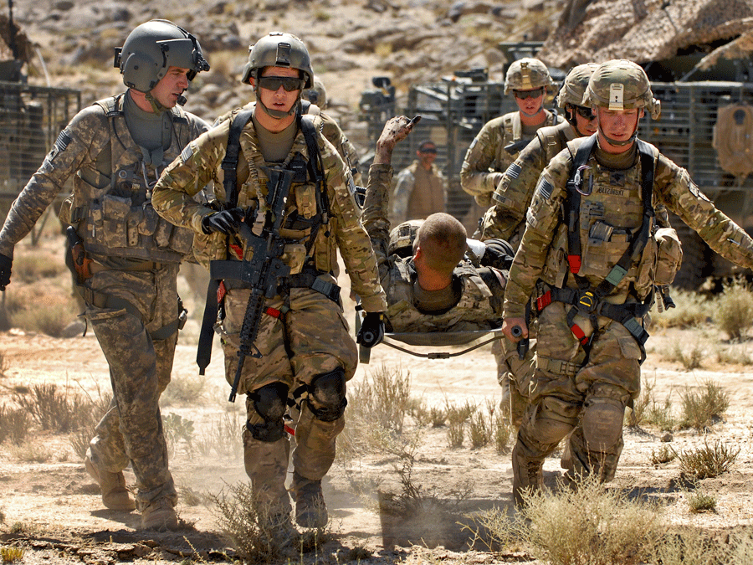
Title: Make a prediction based on the title.

Slide 35
Setting a Purpose for Reading
As you read this newspaper article, think about its audience and purpose (PIE).
Circle unknown words and phrases. Try to determine the meaning of words by using context clues, word parts, or a dictionary.

Slide 36
First Read
Circle unknown words/phrases
Think about the audience and the purpose (PIE)

Slide 37
Second Read
Use your metacognitive markers
Make comments in the my notes section that are related to the markers you used.
Annotation

Slide 38
Key Idea and Details: 5. What is the purpose of the first four paragraphs of this article?
The first four paragraphs state the facts of Seger’s injury.

Slide 39
Craft and Structure: 6. The author uses the word “folks” in paragraph 5 to mean family. What effect does this word choice have?
“Folks” is a casual, informal word for parents or family, so it makes the tone simple and relatable. It creates a level of hominess and comfort.

Slide 40
Key Ideas and Details: 7. Choose a statement made by Segers that expresses the central idea driving Segers’s life now. What facts in the story support this idea?
“Of course, the less of a leg changed me. But it doesn’t define me or the rest of my life.” Facts that support that statement include that he is married, has a career and a child, and runs a marathon.

Slide 41
Key Idea and Details: 8. Notice how the language changes as it describes his Army assignment. What is an “elite” infantry unit? What are “personnel recovery missions”?
The language becomes technical: “elite” means a superior or especially talented group, and his work was to bring soldiers back from the front lines.

Slide 42
Working from the Text: 9. Consider the audience and purpose of each of the texts you just read. How are they similar and different?
The audience of the poem would be individuals who enjoy reading; thus the purpose is to entertain. The article’s purpose would be to inform. So the audience would be individuals reading it for educational purposes.

Slide 43
Working from the Text: 10. How does the structure of each text support its purpose? What language choices does each author make to support his or her purpose?
The structure of the poem supports the shifts in tone and speaker that occur. Its purpose was to entertain the audience and the structure supports this by aligning the shift with it. The language’s impact of the poem comes from the use of imagery and the figurative language at the end, whereas the article uses very straightforward and clear language with no imagery or figures of speech. The structure of the article is also broken into paragraphs based on topic and dialogue, not by intentional shifts.

Slide 44
Working from the Text: 11. Write a paragraph that compares and contrasts the structure and language of both the poem and the article and analyzes how this contributes to their meaning and style.
See 10.

Slide 45
Working from the Text: 12. To determine the theme of both texts, ask yourself, what does each text say about the concept of heroism? Write a theme statement about heroism that connects both texts. Then, write a summary that supports your interpretation using evidence from both the poem and the article.
The theme of both texts is _____. One piece of evidence supporting this theme is_____.

Slide 46
Thematic statements about heroism that connects the texts.
A hero faces the challenge of a serious wartime injury with courage and optimism.
A life changing wound can make an ordinary man become extraordinary.
Heroes may need courage both on the battlefield and at home.

Slide 47
Check Your Understanding: Briefly explain how the character in the poem and Tristan Segers in the article exemplify the concept of hero.
The character and Segers exemplify the concept of hero because they placed themselves in the path of danger for others’ freedom. Each faced physical and emotional challenges related to their sacrifice and overcame them by hard work, determination, and a positive outlook.

Slide 48
Introducing the strategy Free Writing: - Write freely - No pressure - Informal style freedom -Generate ideas - Prepare for formal writing

Slide 49
Notebook: Date Challenges Free write and Essay pg.

Slide 50
Introducing the Freewriting Strategy
Writing Prompt: Write an explanatory essay about a challenge you have faced that includes examples of specific things you did to overcome adversity.
Clearly explain the challenges you faced.
Cite specific examples and experiences that helped you overcome your challenge.
Summarize your outcome clearly.

